Slide 1

Deep Instance Segmentation of Teeth on Dental X-rays using U-Nets
19AIE312 – DLSIP
Guided By Dr. Suja P
TEAM 4-INFINITY
APOORVA M
TANUJ M
AISHWARYA V

Slide 2
ABSTRACT
Automatic teeth segmentation for patients panoramic x-ray images, which is used for dentistry
we propose a post-processing stage to obtain a segmentation map in which the objects in the image are separated, and apply this technique to tooth instance segmentation with U-Net network.
The proposed post-processing stages reduce the mean error of tooth count to 6.15%,
The error without post-processing is 26.81%.
The performances of both segmentation and tooth counting are the highest in the literature, to our knowledge.

Slide 3
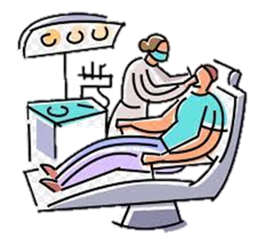
INTRODUCTION
Oral health is an important indicator of overall health, and quality of life.
Major oral diseases include dental caries (tooth decay), periodontal (gum) disease, and oral cancers.
Dental caries is the most common disease globally with increasing prevalence.
Segmentation of teeth is usually a necessary step in the analysis of dental images such as for lesion detection , age or gender determination and human identification.
Deep learning algorithms, in particular convolutional neural networks (CNNs), have rapidly become a methodology of choice for analyzing medical images with the advent of computation hardware/algorithms, increase in the amount of data and superior success.
We propose to apply a post-processing stage to obtain a segmentation map in which the objects in the image are separated and use the technique for tooth instance segmentation with U-Net network.

Slide 4
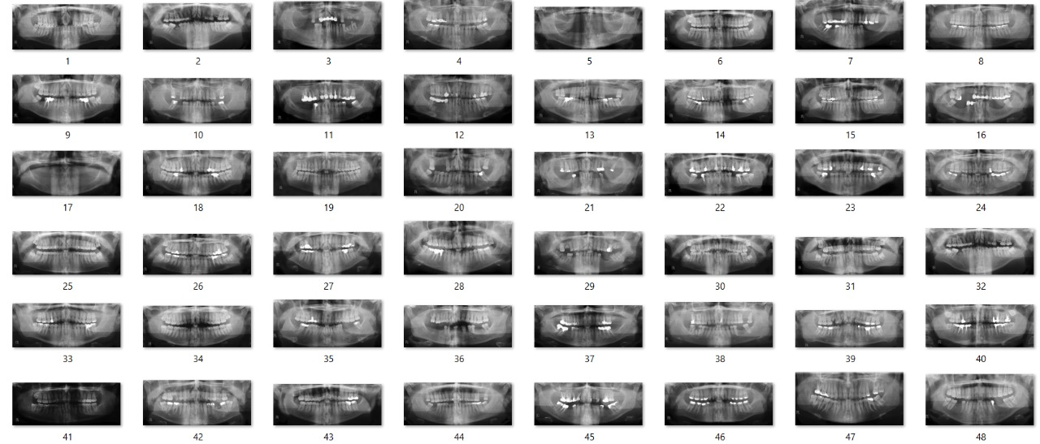
DATASET
Consists of anonymized and de-identified panoramic dental x-ray images of 116 patients
The images have been taken by the Soredex Cranex D digital panoramic x-ray unit
The widths of all images vary between 2600-3138 pixels, their heights are between 1050-1380 pixels\
Complete edentulous cases are excluded in this study

Slide 5
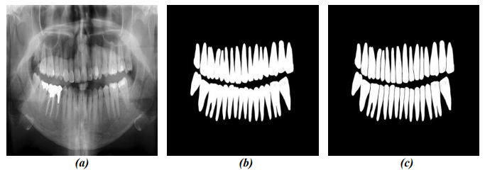
PREPROCESSING
All panoramic dental x-ray images are resized to 512x512 pixels, and normalized in the range of 0 to 1
The original radiograph
Full mask obtained by manual labeling
Split mask, in which each tooth is separated from the others by a narrow gap.

Slide 6
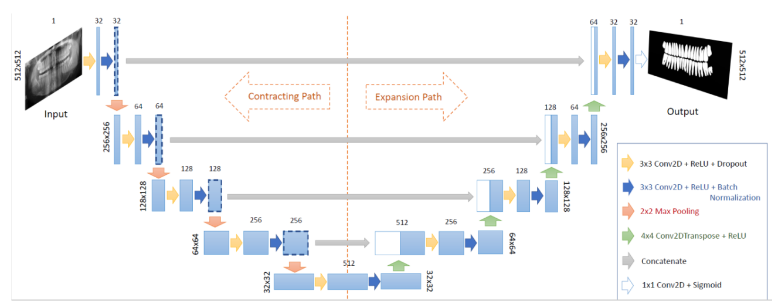
THE U-NET ARCHITECTURE

Slide 7
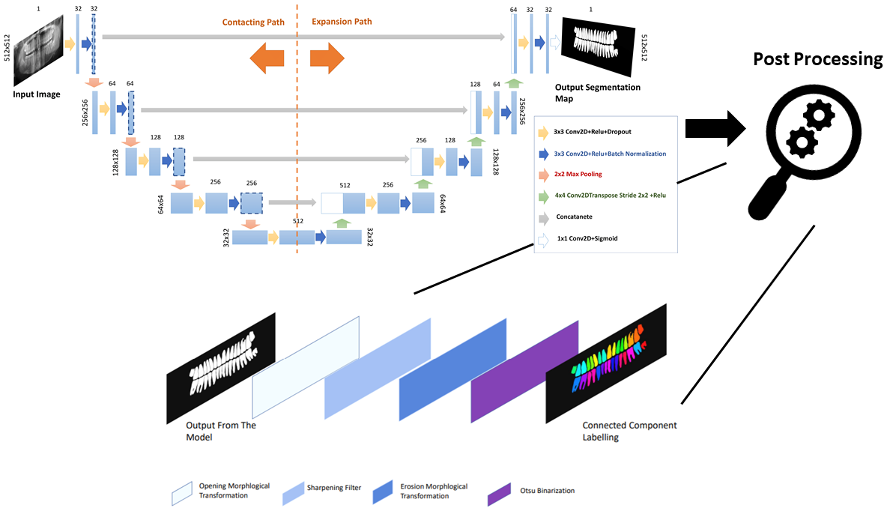
THE NETWORK ARCHITECTURE
The U-Net architecture + Post Processing

Slide 8
TRAINING DETAILS
Implemented in Python using Keras library.
The loss function used is binary cross entropy.
The weights are optimized through the Adaptive Moment Estimation (ADAM) optimizer at 200 epochs with a batch size of 8.
In this study, different combinations of horizontal flipping, vertical flipping, and adding random salt and pepper noise are applied for data augmentation to the training dataset.

Slide 9
PURPOSE OF POST PROCESSING
Separation of tooth instances in the final map is assured by morphological operations.
Each output map produced by the network is processed by a series of basic image processing operations.
The aim of these operations is not only to increase the separation of the teeth from each other, but also to reduce the noise in the final segmentation maps.

Slide 10
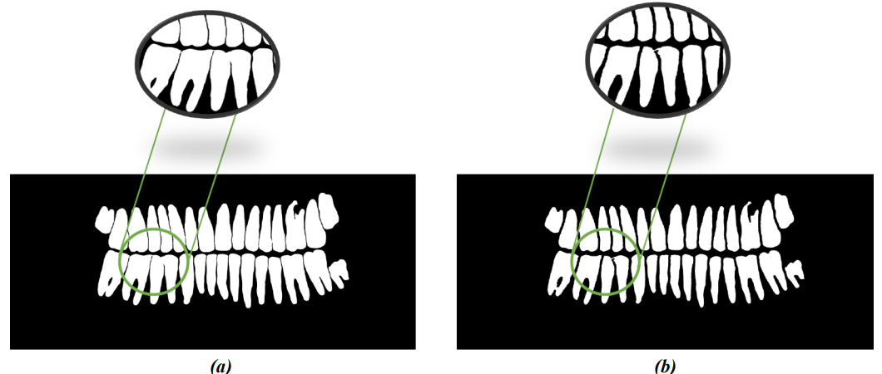

Slide 11
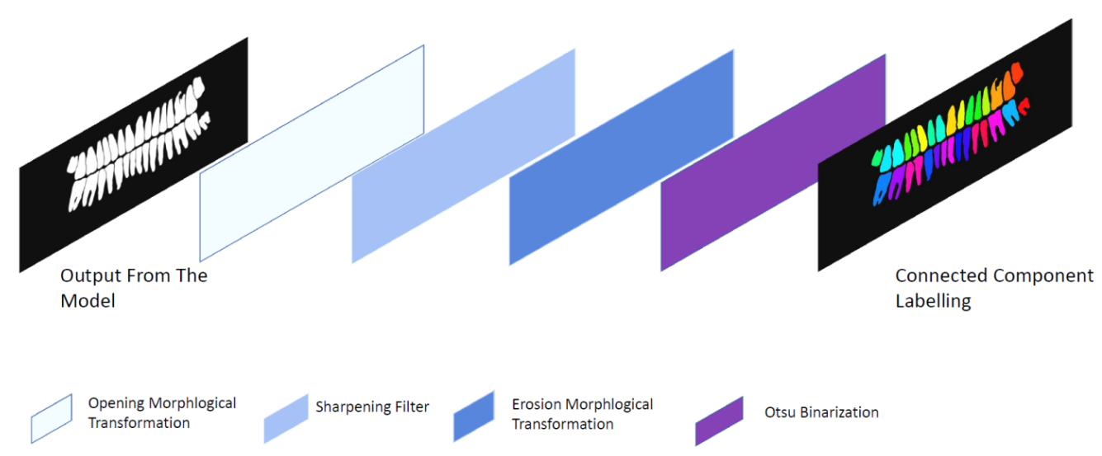
POST PROCESSING
First, the output of the network has been resized to the size of the original input, using a Lanczos filter on all pixels that may contribute to the output value
Morphological grayscale opening operation on resized output map is applied - remove small light details in the image and to separate teeth from each other
Then, the image sharpening filter with a kernel is applied to further enhance the details
To detach the connected teeth, grayscale erosion morphological operation is applied twice to the output map of the sharpening filter
Following the erosion operation, the masks are generated by a segmentation operation, in which the optimum threshold is determined
Subsets of connected components are uniquely labeled on the masks using the connected-component procedure, with a cluster size threshold of 2000 pixels

Slide 12
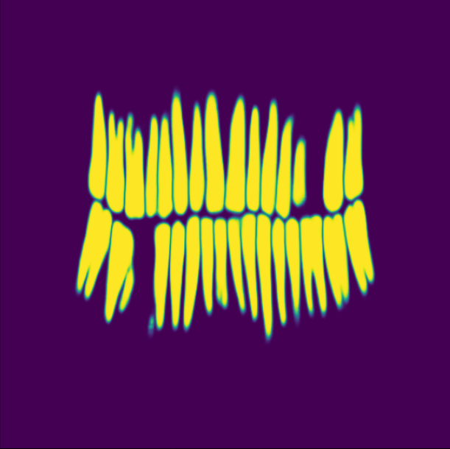
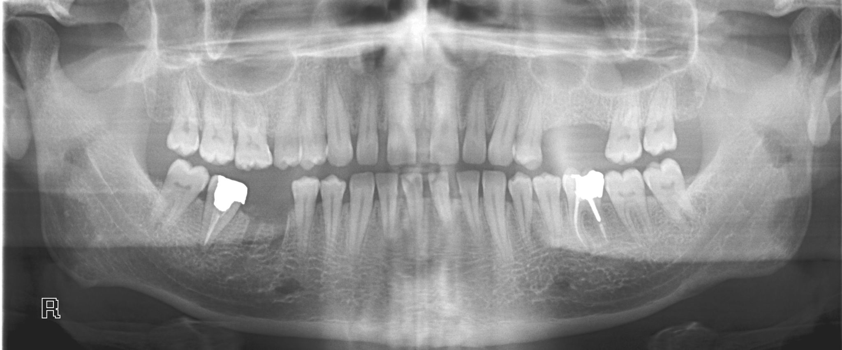
RESULTS

Slide 13
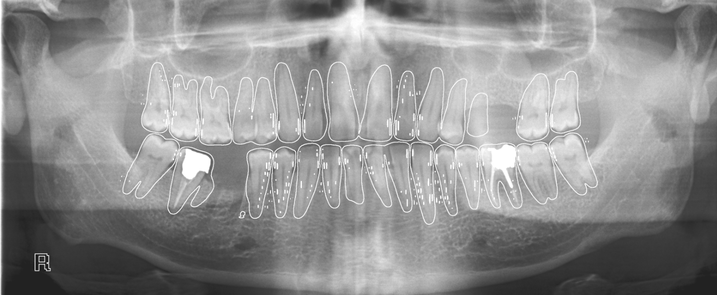
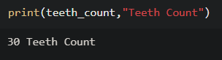
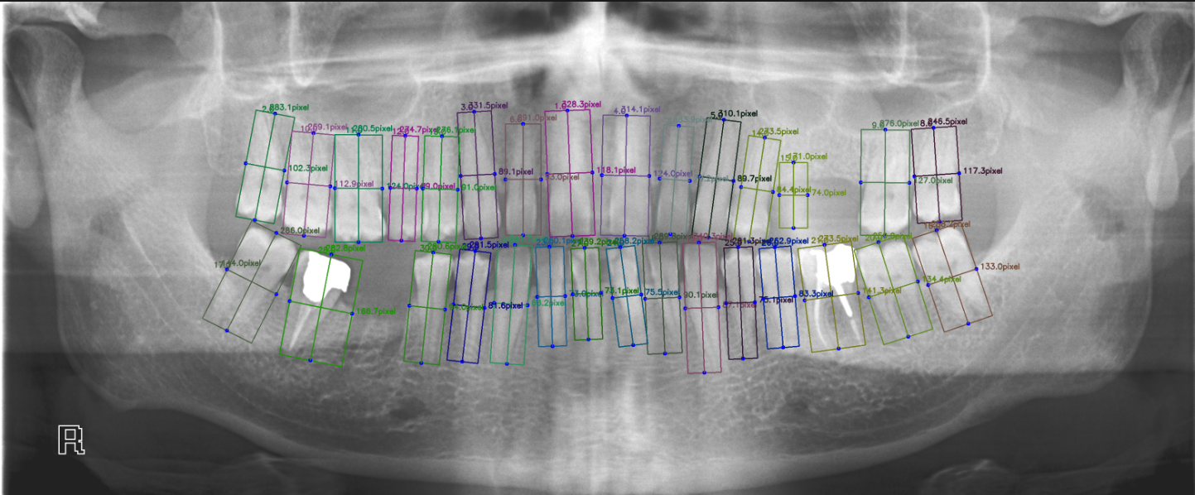

Slide 14
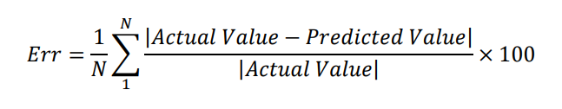
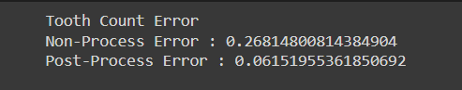
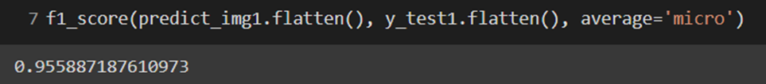
PERFORMANCE EVALUATION

Slide 15
HIGHLIGHTS OF THE STUDY
To compensate the dataset limitation, data augmentation strategies were applied. Adding salt and pepper noise and horizontal flipping resulted a slight increase in the performance.
The performance of counting the number of teeth is significantly improved by the application of the post-processing stages.
In our study, by the proposed technique, the mean error of tooth count is 6.15% which is the lowest in the literature, to our knowledge.

Slide 16
CONCLUSION
In this study, a method to segment and count the tooth instances on panoramic radiographs is proposed
The evaluations demonstrate the potential of the method to help clinical practice
The performances of both segmentation and tooth counting are the highest in the literature, to our knowledge
This has been achieved by using a relatively small training dataset, which consists of 105 images.
Although, the aim in this study is to segment tooth instances, the presented method is applicable to similar problems on other domains, such that separating the cell instances.

Slide 17
FUTURE SCOPE
In the further development of the project ,the application that have been planned to be incorporated are:
Tooth anomaly detection
Missing Tooth and it’s type detection
Detection of Hyperdontia
Teeth Protrusion checking
Diagnosis of oral disease

Slide 18
REFERENCES
G. Jader, J. Fontineli, M. Ruiz, K. Abdalla, M. Pithon, and L. Oliveira, “Deep instance segmentation of teeth in panoramic x-ray images,” in 2018 31st SIBGRAPI Conference on Graphics, Patterns and Images (SIBGRAPI). IEEE, 2018, pp. 400–407.
O. Ronneberger, P. Fischer, and T. Brox, “U-net: Convolutional networks for biomedical image segmentation,” in International Conference on Medical image computing and computer assisted intervention, Springer, 2015, pp.234–241.
N. Shah, N. Bansal, and A. Logani, “Recent advances in imaging technologies in dentistry,” World journal of radiology, vol. 6, no. 10, p. 794, 2014.
M. H. Bozkurt and S. Karagol, “Jaw and teeth segmentation on the panoramic x-ray images for dental human identification,” Journal of Digital Imaging, pp. 1–18, 2020.
Y. Zhao, P. Li, C. Gao, Y. Liu, Q. Chen, F. Yang, and D. Meng, “Tsasnet: Tooth segmentation on dental panoramic x-ray images by two-stage attention segmentation network,” Knowledge-Based Systems, vol. 206, p. 106338, 2020.

Slide 19
THANK YOU

